Slide 1



Slide 2
RAM TECHNOLOGIES BANGALORE Email:
ramtechnologiesblr@gmail.com Mobile:
+91-8095888447 +91-9392559332

Slide 3
Trending Course!!!
AWS DevOps

Slide 4
DevOps Coaching Highlights
Myself: RAM
Having overall 10+ years of professional IT experience including 5+ Years in DevOps/Cloud computing/Automation.
Working as a DevOps Lead in one of the top IT service MNC companies in India.
Trained about 90+ students and Job support 120+ Professionals successfully past few years and many of my students got placed with many large enterprises
Comprehensive hands on knowledge on Linux, ShellScript, Git and Github, Jenkins, Maven, SonarQube, Nexus, Ansible, Docker, Kubernetes and AWS.

Slide 5
Insights!!
The DevOps requirements in the IT market space is expected to grow by 35% by 2024. Getting a DevOps education now is a great investment into your future, which will pay off very fast!
You are in the right place to kick start your career in DevOps. DevOps is one of the top and hot IT skills right now.
Currently almost all the employers are struggling to get right resources in their teams who can do the DevOps and automation work..
You could be that person by attending this trending program!!

Slide 6
Who can learn DevOps!!
DevOps is a set of practices and cultural philosophies that emphasizes collaboration, automation, and integration between development and IT operations teams. DevOps is not limited to a specific role or background; it can be learned and adopted by individuals from various disciplines.
Ex: Developers, System Administrators and IT Operations, Quality Assurance/Testers, Networkengineers, Anyone Interested in IT and Software Development

Slide 7
RoadMap to Become a successful DevOps Engineer
We all know how DevOps is trending right now. And we know where it is going. Let's get to know what skills will make you a successful DevOps engineer.

Slide 8
Top DevOps skills for 2023
1. Any cloud knowledge and experience - AWS, Azure and Google cloud
2. Linux knowledge and scripting - Basic troubleshooting, intermediate scripting, looking at the logs
3. Experience in Git, GitHub, Bitbucket or any version control systems such as SVN, TFVC
4. Experience in Continuous integrations tools such as Jenkins, TeamCity, Circle CI
5. Experience in Infrastructure automation tools such as Terraform, AWS cloud formation
6. Experience in Configuration Management tools such as Ansible, Puppet or Chef
7. Experience in containers such as Docker and Kubernetes
8. Experience in basic to intermediate Scripting. Advanced scripting needed for Sr.Devops folks.
9. Ability to troubleshoot in case builds, deployments failure.

Slide 9
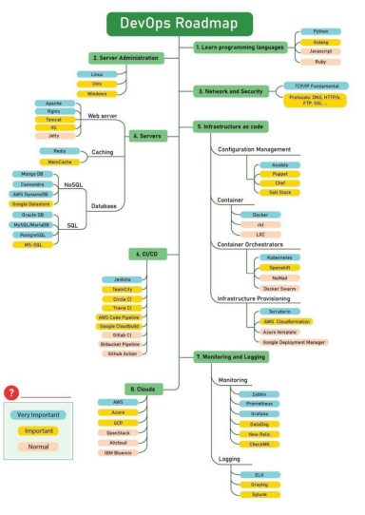

Slide 10
Soft skills
Now a days employers are not only looking for strong technical skills but also looking "soft skills" which are essentials to become successful in IT. If you think if you are lagging on any of these skills, no worries. All these skills can be developed and improved over period of time by practicing.
1. Open minded
2. Willingness to learn new skills
3. Communication
4. Approachable
5. "Get it done" attitude
6. Being adaptable.

Slide 11
Course Content
AWS
Create an account in AWS
services :
1.EC2
2.VPC
3.IAM
4.RDS
5.S3
6.ECR
7.EKS

Slide 12
Linux
Installing Pre-requisite Softwares (SSH Tools and FTP Tools) in Desktop/Laptop.
Understand Linux Command Line.
Linux File/Directory structure.
Linux Commands.
Files and Navigation
Permissions
Processes
Networking
Compressing
System info

Slide 13
Shell Scripting
^{Introduction}
^{What is Shell?}
^{Types of Shells}
^{What is Shell Scripting?}
^{First Shell Script program}
^{File Naming Conventions}
^{Comments}
^{Variables}
^{Command line Arguments}

Slide 14
Shell Scripting
^{Escape Characters}
^{String}
^{Arithmetic Operations}
User Interaction using read command
^{Input and Output Redirection}
^{Control commands – if}
^{Control commands – for}
^{Control commands – while loop}
^{Control commands – Switch case}
^{Functions}
^{Pipe}

Slide 15
SCM Tool-Git and GitHub
What is git?
What is the VCS?
What is SCM?
What is Branch?
What is Tag?
Git Administration.
Git commands
Working with git as a Developer perspective
SSH Key generation
PAT creation
Cloning Repositories
Merging Branches
Branching strategy
Best practices for Releases/Code commits in any VCS

Slide 16
Build Tool-Maven
Introduction
Features & Benefits of Maven
Installation (Maven Environment Setup)
Directory Structure
Content of pom.xml
Maven Repositories
Maven Life Cycles
Executing some Examples
Maven Multi Modules
Parent pom
Child pom

Slide 17
Apache Tomcat
Introduction
Difference between App server and Web server
Understating of Web Servers, App Servers and Database Servers
Installation (In Windows - Extraction, In Linux Installation)
Directory structure
Start the Tomcat server
Stop the server
Users creation
Roles
Port number change
Application Deployment
Through Admin Console
Copy artifact into webapps folder
Tomcat Tuning
Data source Creation

Slide 18
Code Quality Tool-SonarQube
Introduction
Pre-Requisites
Architecture
Installation
Change the Port Number
Execution
Administration
Users Creation (Normal User and Administrator)
Project Creation
Project deletion
Token Generation
Create Quality Profiles
Create Quality Gates
Configure Email settings

Slide 19
Artifactory Mgmt Tool-Nexus
Introduction
Installation
Password and Email change for Admin User
Email server Configuration
Port Number Change
Context root change
Nexus Directory structure
Create the Repositories (maven2hosted, maven2proxy, maven2group and docker..)
Integrate the Maven with Nexus
Create Users
Nexus API

Slide 20
CICD Tool-Jenkins
Introduction
Continuous Integration (CI)
Continuous Delivery (CD)
Continuous Deployment (CD)
Installation in Linux and Windows
Create the Maven Project using Freestyle Project type
Integrate Maven software if not done.
Integrate Nexus with Jenkins
Integrate SonarQube with Jenkins
Deploy the App into Tomcat
Through “Deploy to container” plugin
Through Script – SSH Agent Plugin
Configure Email Functionality
Poll SCM
Build Periodically

Slide 21
Jenkins
Git Web Hooks
Discard Old Build
Disable this project
Delete workspace before build starts
Add timestamps to the Console Output
JACOCO plugin
Plugin Management
Safe Restart
Next Build Number
Email Extension
SonarQube Scanner
Schedule Build
Artifactory Plugin
Cloud Foundry

Slide 22
Jenkins
Blue Ocean
Deploy to container
Deploy WebLogic
Maven Integration
JACOC
SSH Agent
Publish Over SSH
Thin Backup
Build Name Setter
Convert To Pipeline

Slide 23
Configuration Mgmt Tool-Ansible
Introduction
Architecture
ssh-key generation
Copy SSH Key
Ansible adhoc Commands
Ansible Playbooks
Execution of Ansible Playbooks
Ansible Modules
Roles
Ansible Vault
Ansible Galaxy

Slide 24
Container Tool-Docker
Docker Introduction
Containerization Vs Virtualisation
Docker Vs Virtual Machine
Docker Installation
Dockerfile
Dcoker Image
Docker Container
Docker Adhoc Commands
Docker Networks

Slide 25
Docker
Docker Volumes
Docker Keywords
Dockerfile Creation
Docker Images creation
Docker Images save to Dockerhub
Docker Compose
Docker Swarm

Slide 26
Container Orchestration Tool-Kubernetes
Kubernetes Introduction
Architecture
Kubernetes Cluster(Self-Managed) Setup Using Kubeadm.
Kubernetes Namespace
Kubernetes Objects o POD o Replication Controller o Replica Set o Daemon Set o Deployment Rolling Update Recreate o Stateful Set o Service o Volumes o Persistent Volume o Persistent Volume Claim o Dynamic Volumes o Config Maps & Secrets
HPA & Metrics Server
Kubernetes Cluster Setup In AWS Using KOPS
EKS Kubernetes Cluster Setup Using Terraform
Load balancer Service

Slide 27
Kubernetes
Ingress Controller & Resource
Liveness & Readiness probes
Kubernetes RBAC
Kubernetes & Jenkins Integration
Kubernetes Dashboard Setup
Helm
Monitor Kubernetes Using Prometheus And Grafana.
Log aggregation Using EFK

Slide 28


Slide 29
What is SDLC?
The Software Development Life Cycle (SDLC) is a well-defined procedure for producing high-quality, low-cost software in the shortest amount of time possible. The SDLC's purpose is to create exceptional software that exceeds all customer expectations and demands. The SDLC develops and describes a detailed plan that includes stages, or phases, each with its own process and deliverables. It describes the entire development process, including all tasks involved in planning, developing, testing, and distributing a software product.

Slide 30
SDLC
What is SDLC?
The Software Development Life Cycle (SDLC) is a well-defined procedure for producing high-quality, low-cost software in the shortest amount of time possible. The SDLC's purpose is to create exceptional software that exceeds all customer expectations and demands. The SDLC develops and describes a detailed plan that includes stages, or phases, each with its own process and deliverables. It describes the entire development process, including all tasks involved in planning, developing, testing, and distributing a software product.

Slide 31
SDLC MODELS
3 Types
Waterfall model-Monthwise
Agile or scrum Model-2 weeks
Kanban model-Everyday

Slide 32
Waterfall model
The waterfall model follows a linear and sequential approach to software development.
It consists of distinct phases, such as requirements gathering, design, implementation, testing, deployment, and maintenance.
Each phase is completed before moving on to the next, making it a rigid and structured model.

Slide 33
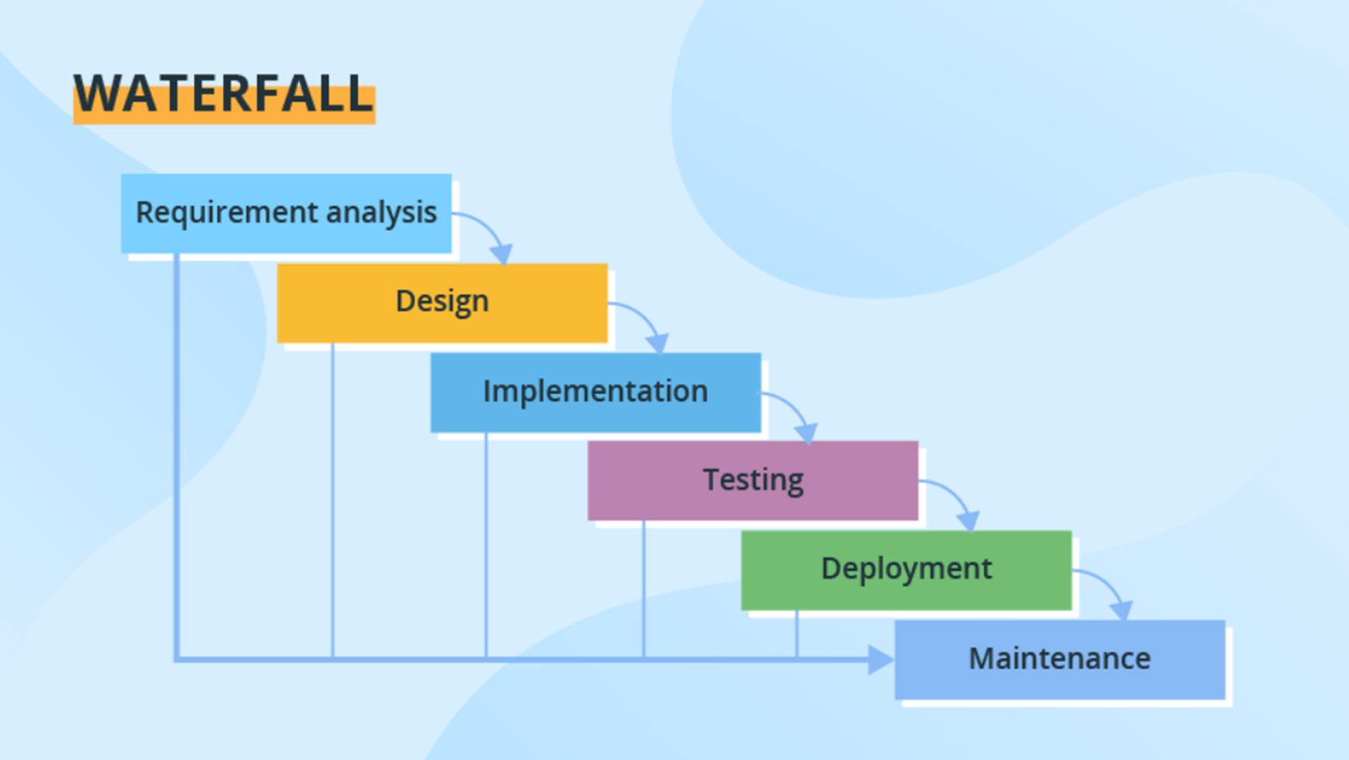

Slide 34
Agile or scrum Model
Agile is an iterative and incremental SDLC model that emphasizes flexibility, collaboration, and rapid delivery.
It involves breaking the development process into small iterations called sprints, where requirements, development, and testing occur concurrently.
Agile methods, such as Scrum and Kanban, promote adaptive planning and regular customer feedback.

Slide 35
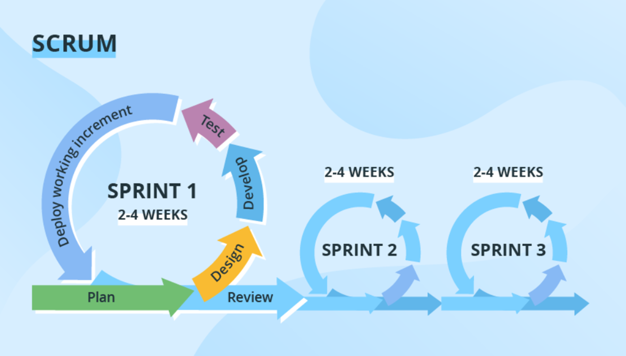

Slide 36
Kanban model
Kanban is a project management method that originated in the manufacturing industry but has been widely adopted in software development and other knowledge work domains.
It provides a visual framework for managing tasks and workflows, promoting efficiency, transparency, and continuous improvement

Slide 37
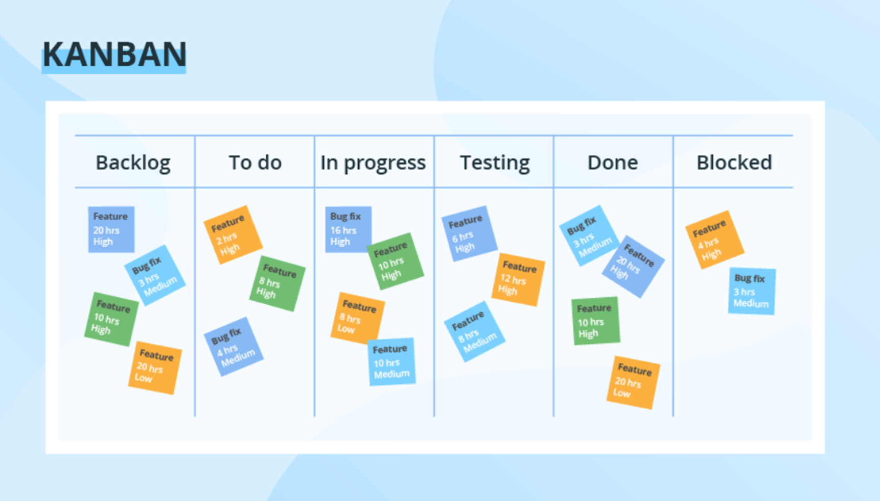

Slide 38
DevOps Vs Agile
Agile is a set of values and principles about how to develop software in a systematic way.
Where as DevOPs is a way to quickly, easily and repeatedly move that software into production infrastructure, in a safe and simple way.
In oder to achieve that we use a set of DevOps tools and techniques.

Slide 39
DevOps
DevOps is a methodology.
It is a combination of Development + Operations
DevOps is a combination of tools, practices and philosophies which enables organizations to release more features, services at high velocity with more frequency
DevOps helps you to reduce the disconnection between s/w developers, Quality Assurance (QA) engineers, and system administrators.
This allows a single team to handle the entire application lifecycle, from development to testing, deployment and operations. With the help of DevOps, quality and speed of the application delivery has improved to a great extent.

Slide 40
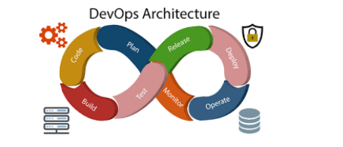
DevOps Architecture:It is used for the application hosted on the cloud platform and large distributed applications. Agile development is used here. So, that integration and delivery can be contiguous.

Slide 41
Features of Architecture
Automation
Collaboration
Automation can reduce time consumption, especially during the testing and deployment phase. The productivity increases and releases are made quicker by automation. This will lead in catching bugs quickly. So, we can fix easily.
The Development and Operations team collaborates as a DevOps team, which improves cultural model as the teams become more productive with their productivity, which strengthens accountability and ownership

Slide 42
Features of Architecture
Integration
Configuration Management
Applications need to be integrated with other components in the environment. The integration phase is where the existing code is combined with new functionality and then tested.
It ensure/make sure the application to interact with only those resources that are concerned with the environment in which it runs. The configuration files are not created where the external configuration to the application is separated from the source code. The configuration files can be written during deployment, or they can be loaded at the run time, depending on the environment in which it is running.

Slide 43
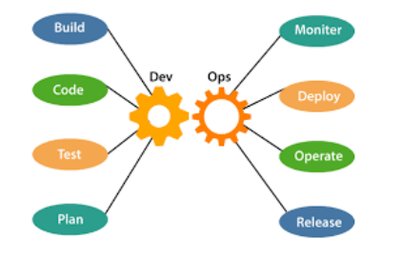
Components

Slide 44
Components
Below components are done by development team
Below components are done by Operations team
1. Plan
2. Code
3. Build
4. Test
1. Deploy
2. Monitor
3. Operate
4. Release

Slide 45
Devops-philosophy
Automate repetitive tasks and always thing for improvements
Don't work in silos make sure you collaborate and communicate on time with other members and teams.
Keep shorter software development lifecycles for example 2 weeks releases.

Slide 46
Devops - Life Cycle
DevOps defines an agile relationship between operations and development.
It is a process that is practiced by the development team and operational engineers together from beginning to the final stage of the product

Slide 47
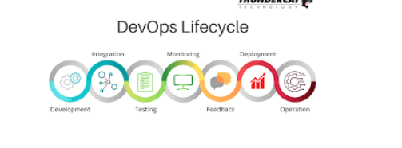

Slide 48
Seven Phases (7)
Continuous Development
Continuous Integration
Continuous Testing
Continuous Monitoring
Continuous Feedback
Continuous Deployment
Continuous Operations

Slide 49
Devops - Practices
Continuous Integration
Continuous Delivery
It is a development practice where developers should integrate changes
To their central repositories like Git daily to reduce conflicts and bugs.
It expands upon CI, it is automated process to deploy the code all the way from development to production Approval is required before promoting changes to production environment

Slide 50
Devops - Practices
Continuous Deployment
Configuration Management
Tt does not require approval
99% of customers don't follow this
Is a process where we maintain infrastructure and software changes through automation and
the goal is to maintain them in desired state.
For instance I wanna set up a tomcat server on 100 servers. This activity can be automated
using configuration management tool
It saves lots of time and it makes it easy to fix defects if any.
Popular configuration management tools are
Ansible, Puppet, Chef and Saltstack

Slide 51
Devops - Practices
Microservices Architecture
Monitoring
In this architecture big application(single code base) is divided into smaller services so that we get following benefits
We can release more services Development will be much faster We can scale any specific service alone
It is very important to monitor applications and services after it is deployed into production

Slide 52
What Are Benefits Of DevOps
DevOps is gaining more popularity day by day.
Here are some benefits of implementing DevOps Practice.
Release Velocity: DevOps enable organizations to achieve a great release velocity.
We can release code to production more often and without any hectic problems.
Development Cycle: DevOps shortens the development cycle from initial design to production.
Full Automation: DevOps helps to achieve full automation from testing, to build, release
and deployment.
Deployment Rollback: In DevOps, we plan for any failure in deployment rollback due to a
bug in code or issue in production. This gives confidence in releasing feature without
worrying about downtime for rollback.
Defect Detection: With DevOps approach, we can catch defects much earlier than
releasing to production. It improves the quality of the software.
Collaboration: With DevOps, collaboration between development and operations
professionals increases.
Performance-oriented: With DevOps, organization follows performance-oriented culture in
2/71
which teams become more productive and more innovative.

Slide 53
DevOps workflow
The typical DevOps workflow is as follows:
Atlassian Jira for writing requirements and tracking tasks.
Based on the Jira tasks, developers checking code into GIT version control system.
The code checked into GIT is built by using Apache Maven.
The build process is automated with Jenkins.
During the build process, automated tests run to validate the code checked in by a developer.
Code built on Jenkins is sent to organization’s Artifactory.
Jenkins automatically picks the libraries from Artifactory and deploys it to Production.
During Production deployment, Docker images are used to deploy same code on
multiple hosts.
Once a code is deployed to Production, we use monitoring tools like nagios are used to check the health of production servers.
Splunk based alerts inform the admins of any issues or exceptions in production.

Slide 54
What is Cloud Computing
It is the use of remote servers on the internet to store, manage and process data rather than a local server or personal computer. There are basically 3 categories in cloud computing
1.SAAS
2.PAAS
3.IAAS

Slide 55
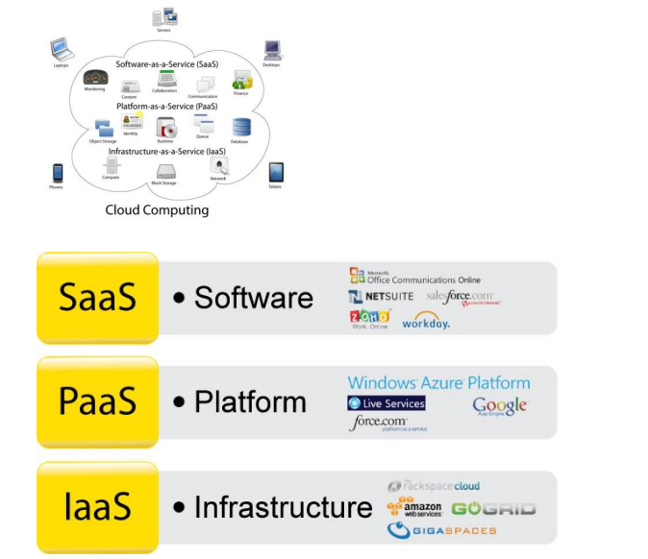

Slide 56
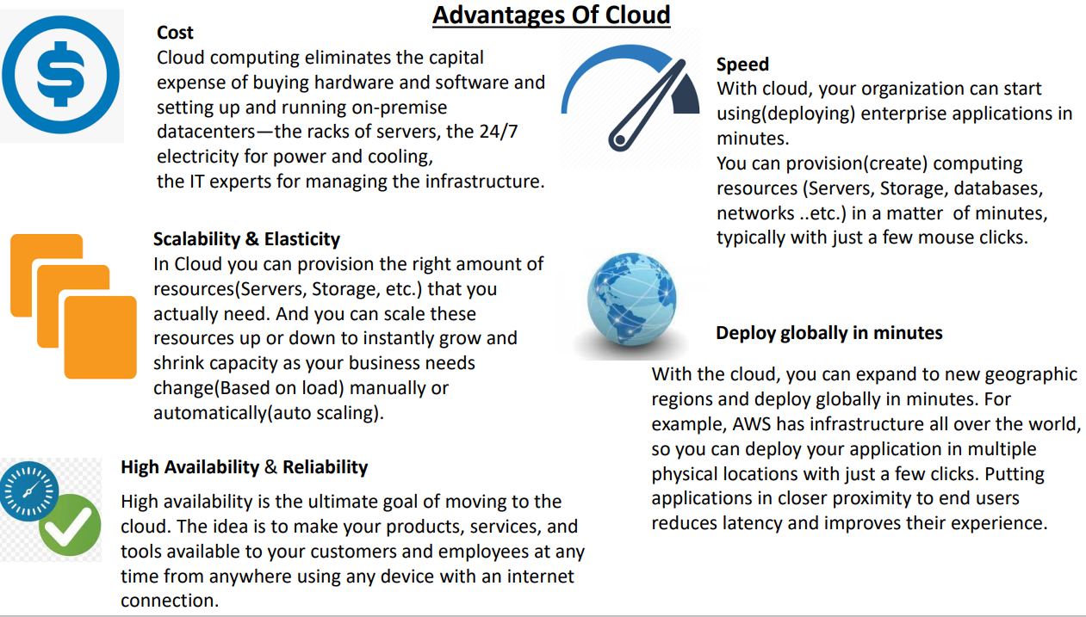

Slide 57
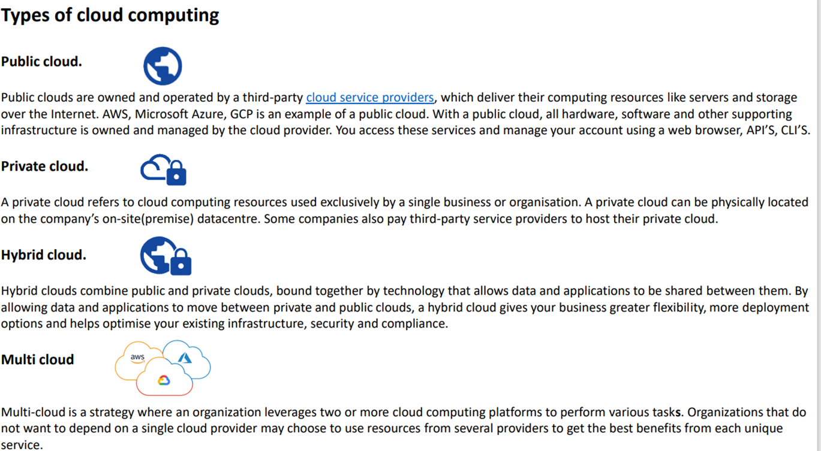

Slide 58
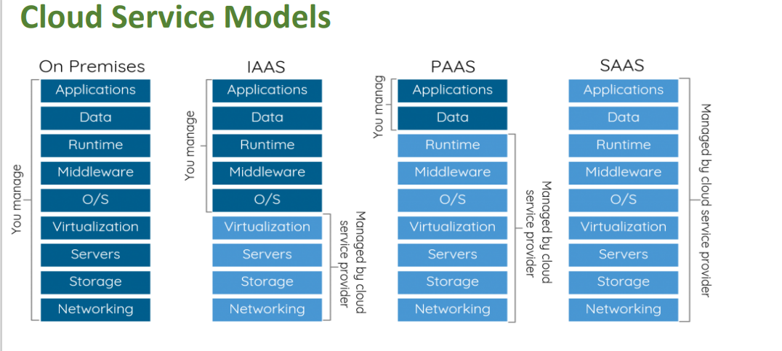

Slide 59
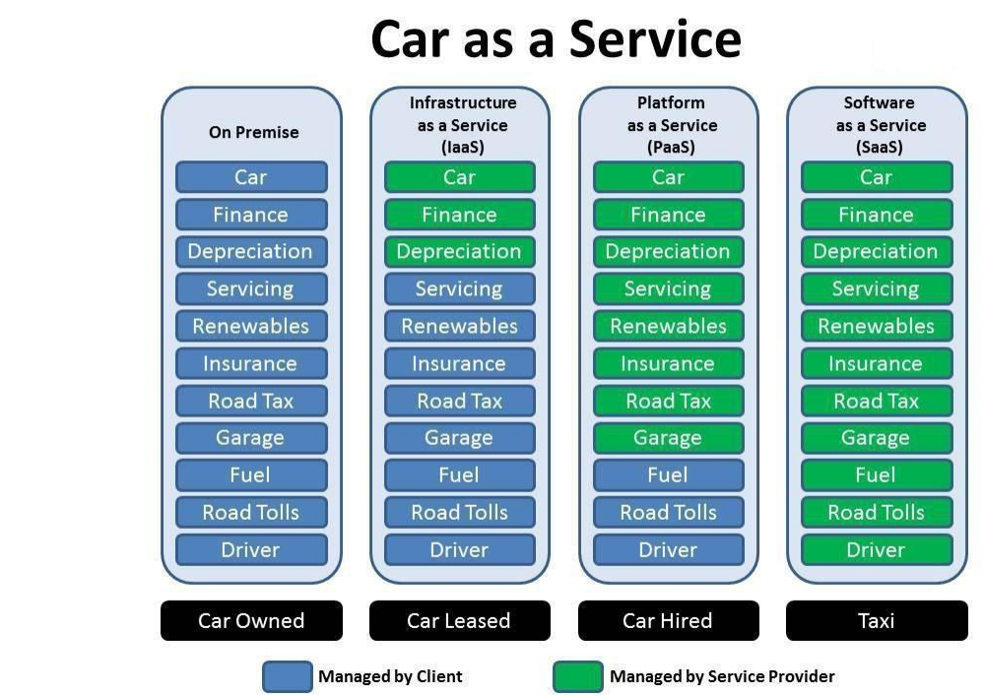

Slide 60
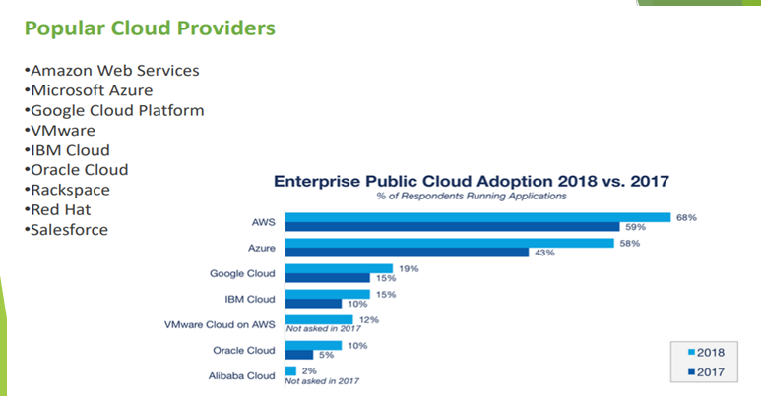

Slide 61
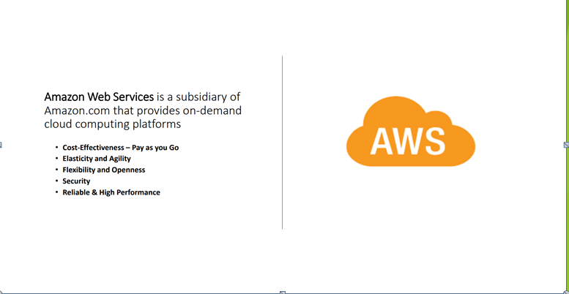

Slide 62
Uses of AWS
A small manufacturing organization uses their expertise to expand their business by leaving their IT management to the AWS.
A large enterprise spread across the globe can utilize the AWS to deliver the training to the distributed workforce.
An architecture consulting company can use AWS to get the high-compute rendering of construction prototype.
A media company can use the AWS to provide different types of content such as ebox or audio files to the worldwide files.

Slide 63
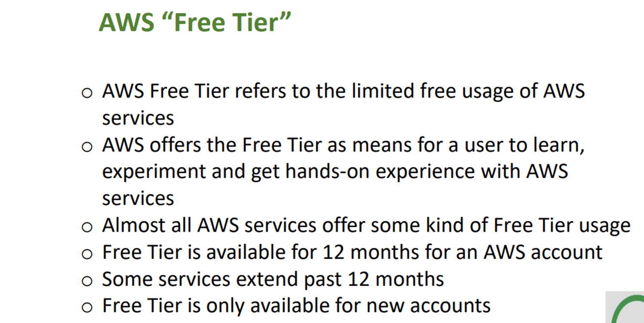

Slide 64
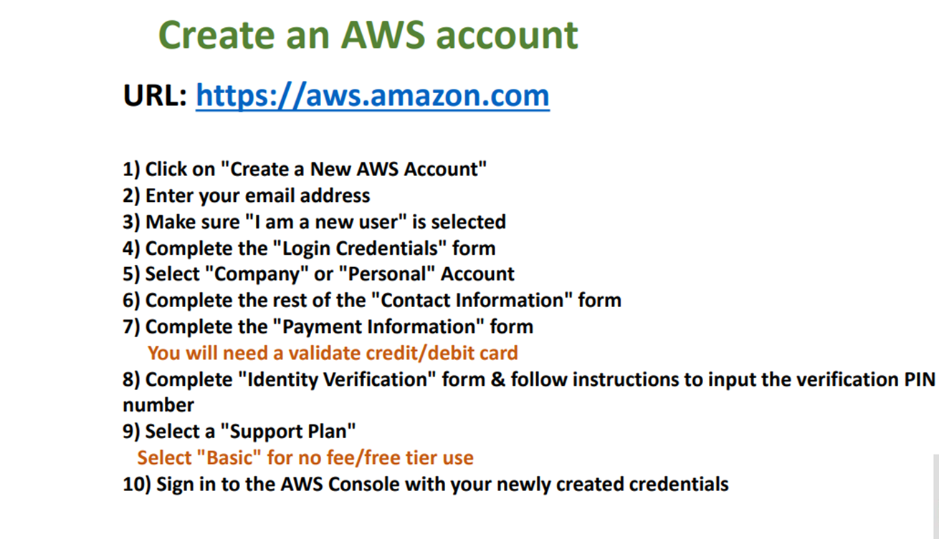

Slide 65
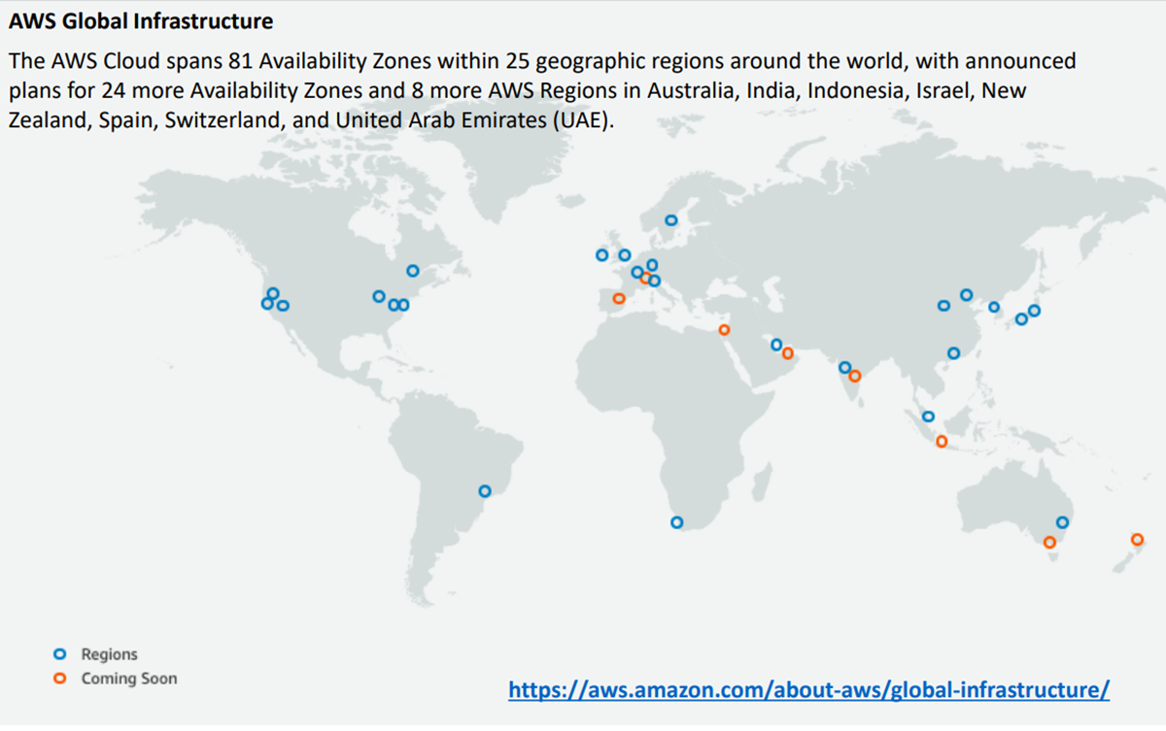

Slide 66
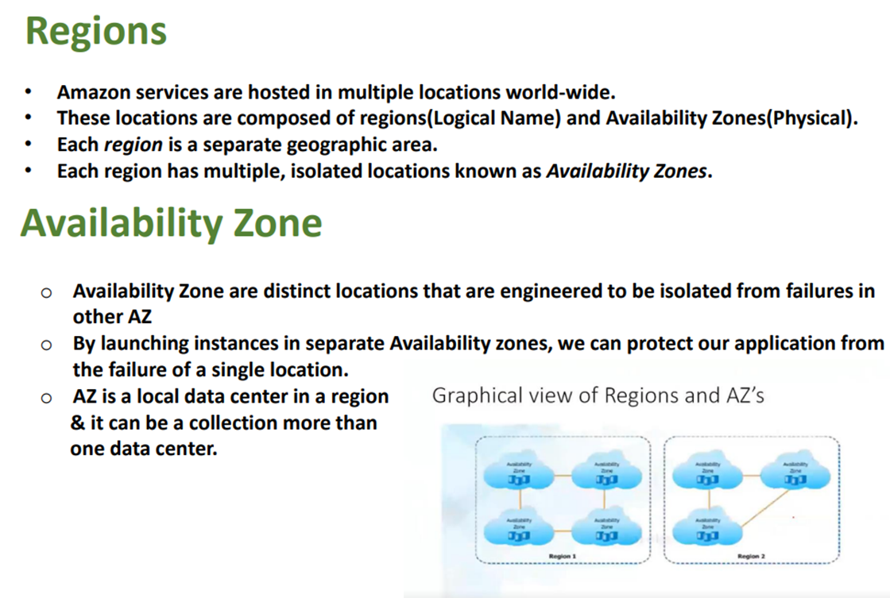

Slide 67
AWS SERVICES
EC2 — Elastic Cloud Computing
IAM — Identity and Access Management
VPC—Virtual Private Cloud
EBS—Elastic Block Storage
Rds — Relational Database Service
S3 — Simple Storage Service
Ecs — Elastic Container Service
Ecr — Elastic Container Registry
EKS--Elastic Kubernetes Service
CLOUD WATCH etc…

Slide 68
EC2
EC2 stands for Amazon Elastic Compute Cloud.
It is a web service which provides re-sizable compute capacity in the cloud.
It is designed to make the web scale computing easier for developers

Slide 69
AWS EC2 offers 5 types of instances
General Instances
Compute Instances
For applications that require a balance of performance and cost.
▪ E.g email responding systems, where you need a prompt response as well as the it should be cost effective, since it doesn’t require much processing.
t2
m4
m3
For applications that require a lot of processing from the CPU.
▪ E.g analysis of data from a stream of data, like Twitter stream
C4
C3

Slide 70
Memory Instances
Storage Instances
For applications that are heavy in nature, therefore, require a lot of RAM.
▪ E.g when your system needs a lot of applications running in the background i.e
multitasking.
R3
x1
For applications that are huge in size or have a data set that occupies a lot of space.
▪ E.g When your application is of huge size.
I2
d2

Slide 71
GPU Instances
For applications that require some heavy graphics rendering.
E.g 3D modelling etc..
G2

Slide 72
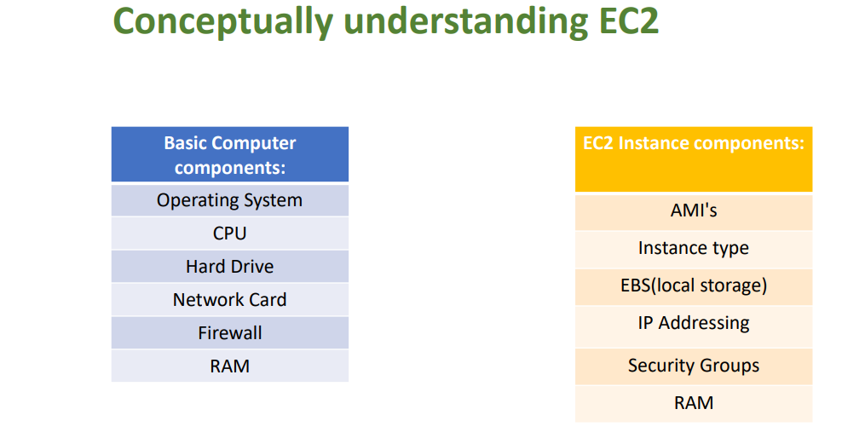

Slide 73
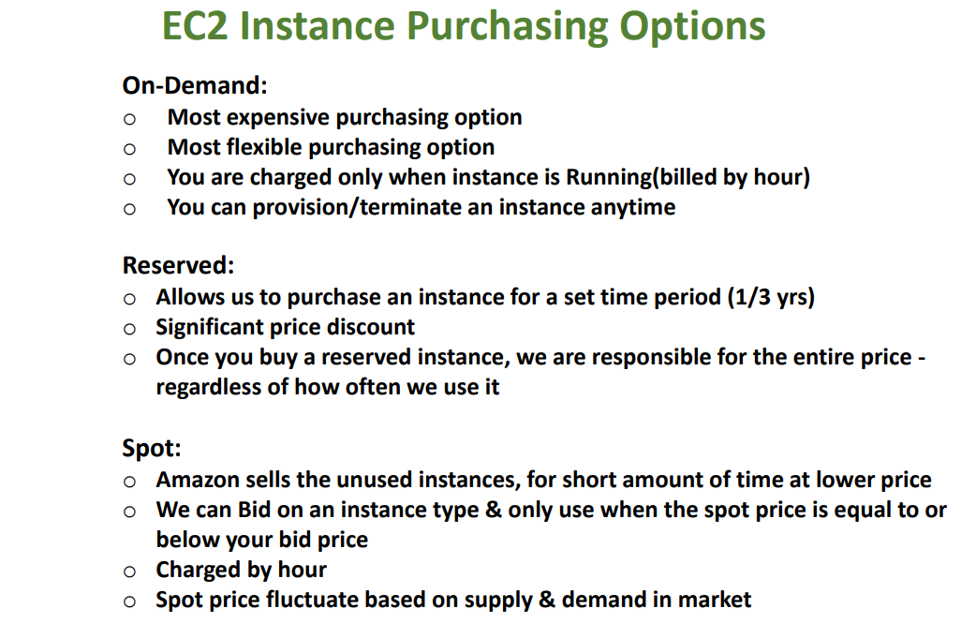

Slide 74
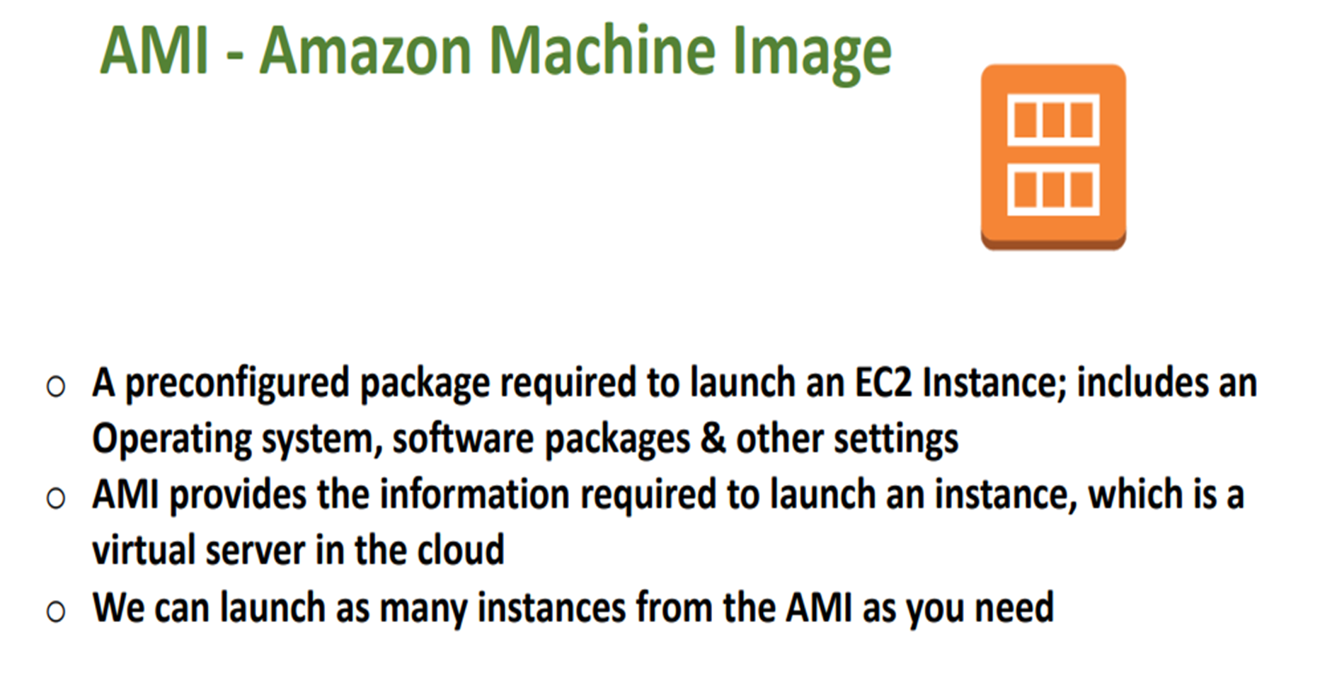

Slide 75
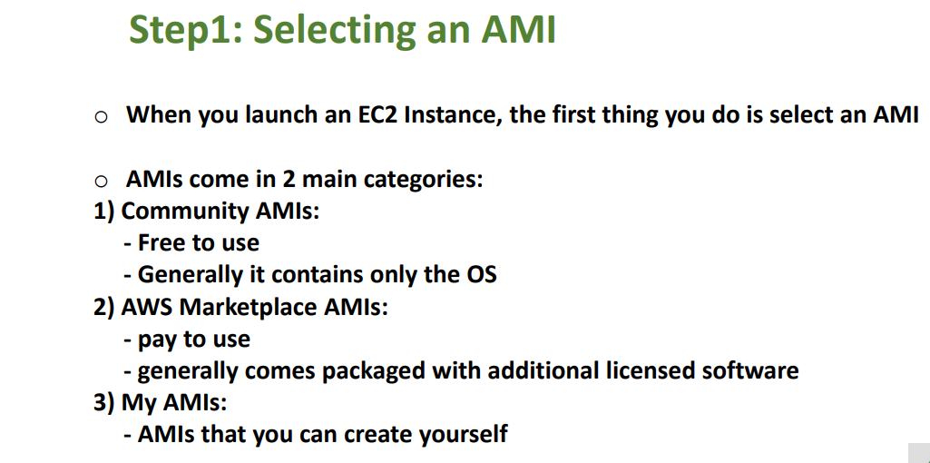

Slide 76
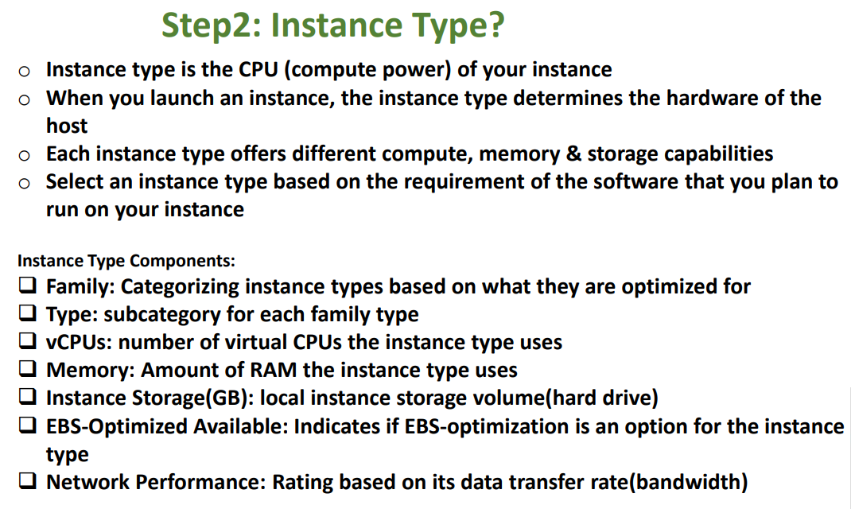

Slide 77
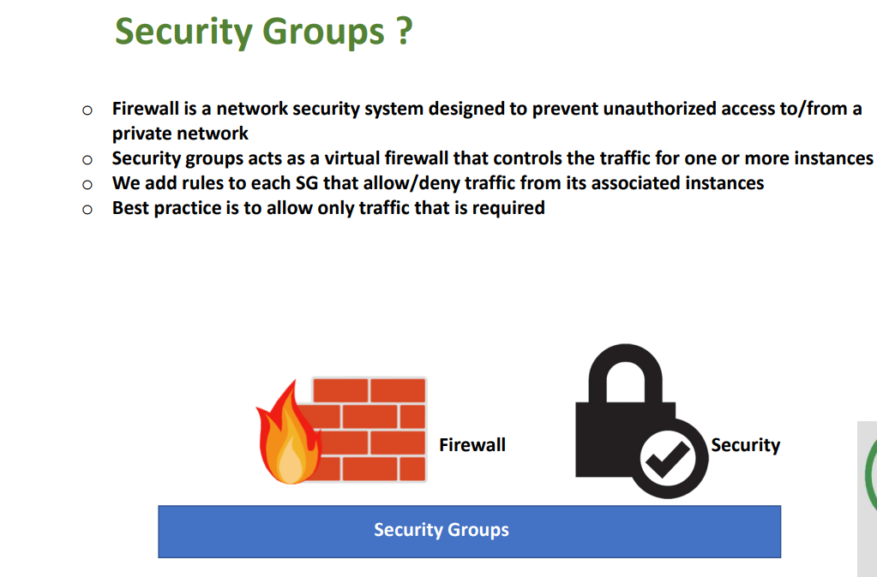

Slide 78
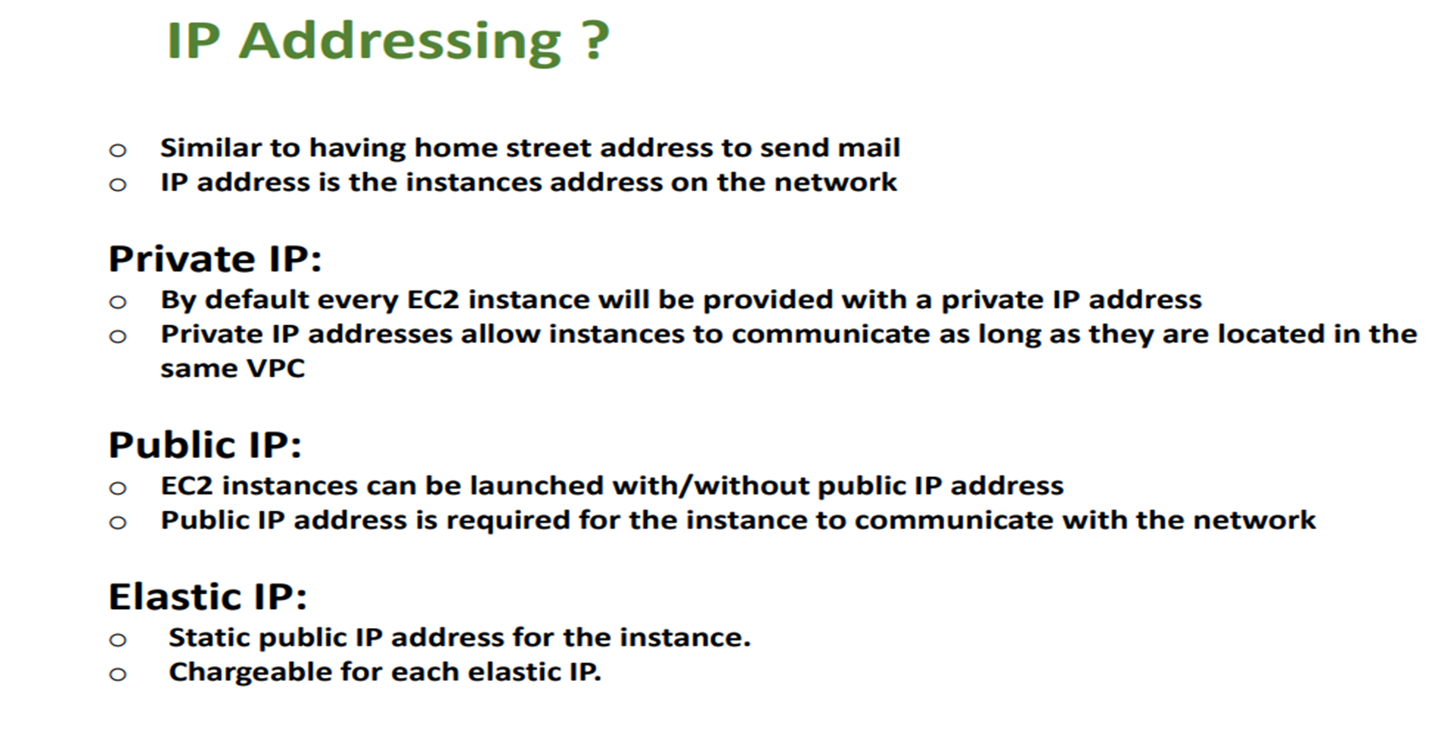

Slide 79
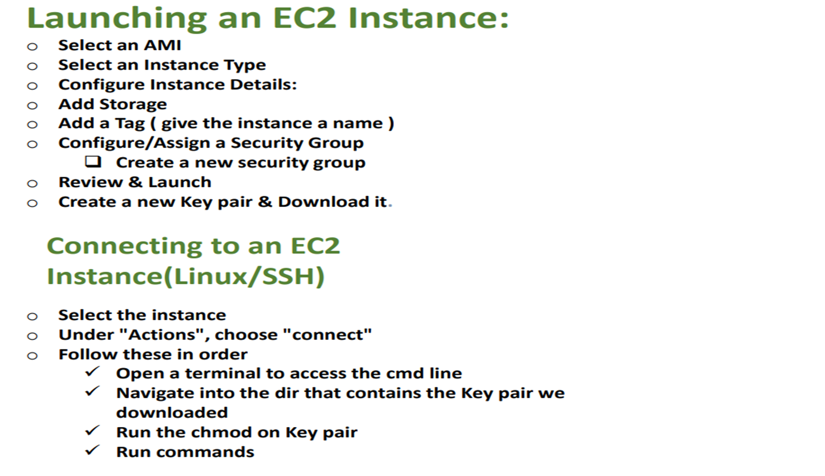

Slide 80
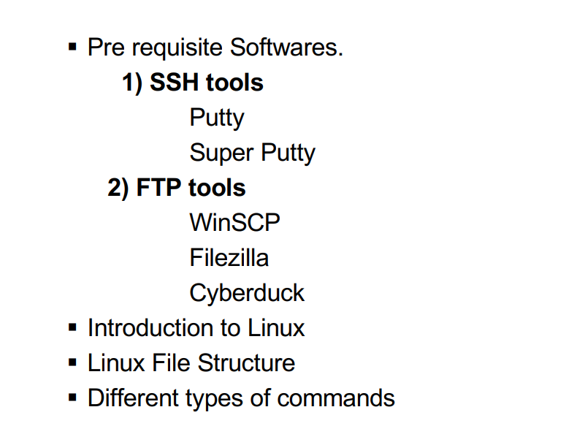
Linux

Slide 81
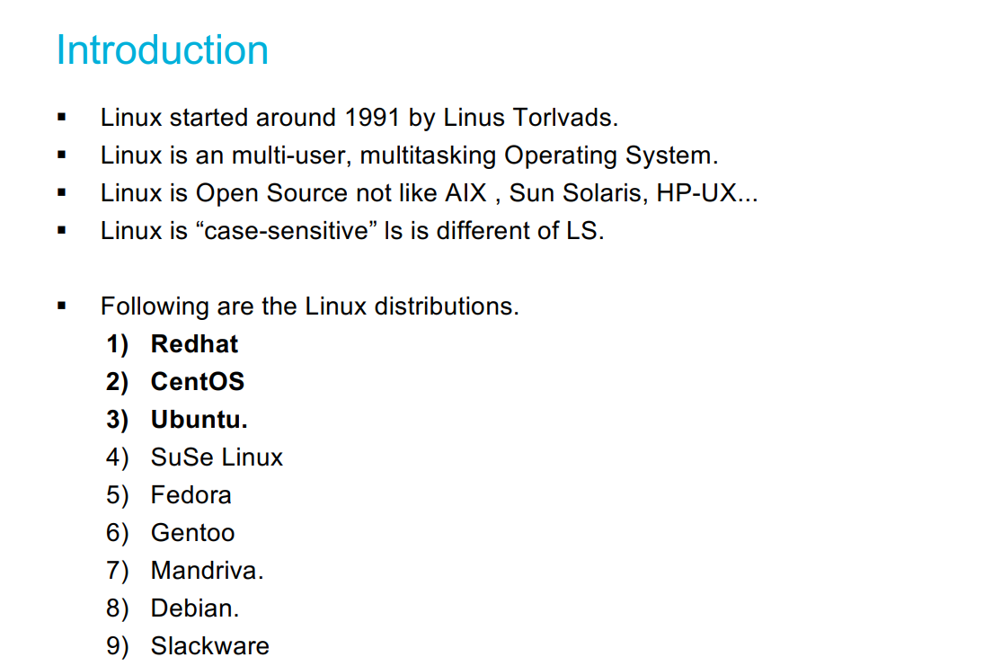
Linux

Slide 82
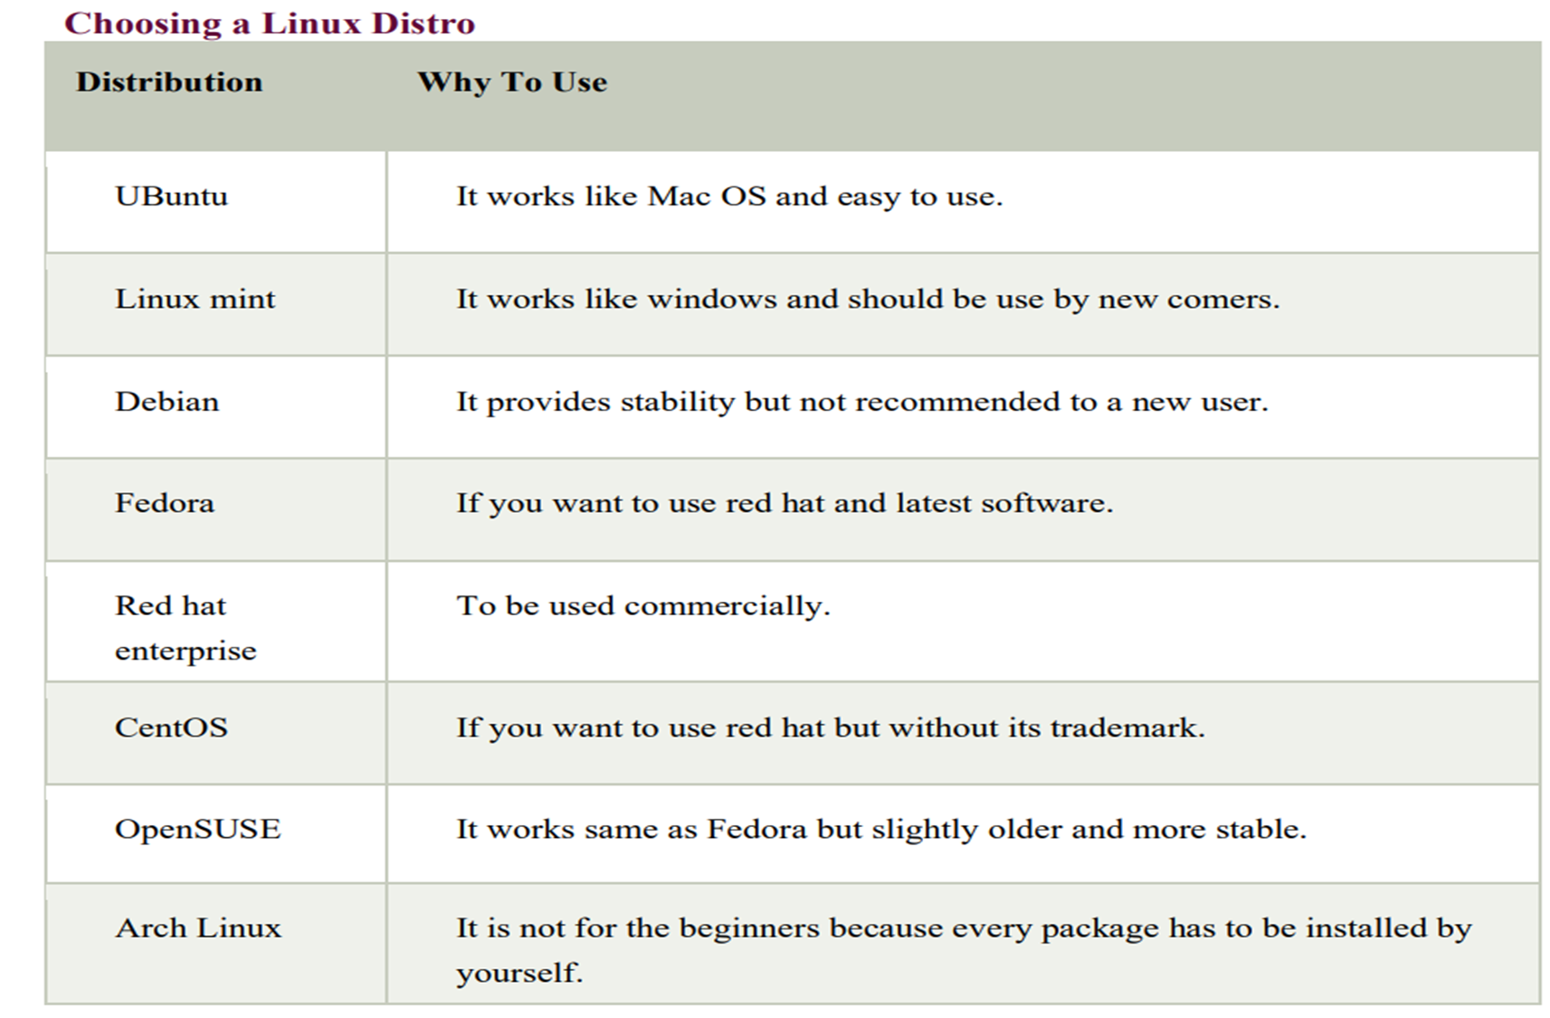

Slide 83
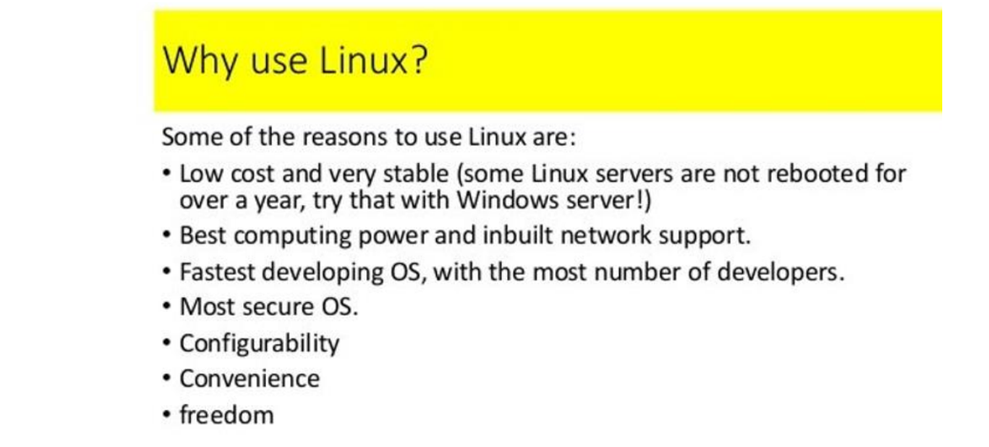

Slide 84
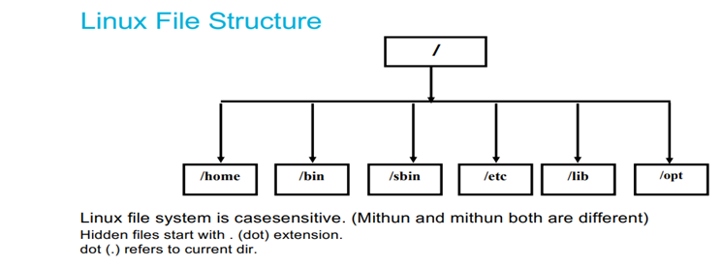

Slide 85
Linux File System
In linux everything is a file
Linux do not contain physical hard drive like windows
Linux has a logical hierarchical file structure
Linux is case sensitive
/ is the Root directory
Hidden files start with (.)dot extension
Dot(.) refers to current directory

Slide 86
1)/bin - In this binaries folder we are having commands
2)/opt - If we download 3rd party s/w in linux that will store in this optional folder
3)/boot - whenever you on the system, booting data present. So that boot code will present in this folder
4)/root - Root user data present
5)/dev - device folder - External devices info stored here
6)/home - Every user data stored here

Slide 87
7)/tmp - we can store the temporary data
8)/usr - In linux kernel info and system binaries info present in user folder
9)/lib - shareable files present in libraries folder
10)/sbin - system binaries -extra commands present when we compared to bin
11)/mnt - mount - If we put pendrive, usb from external that data is coming into this directory
12)/var - In this variable folder, all logs stored.

Slide 88
Linux Commands
i) System Commands
uname : used to get the Operating System of the server. Eg:- Linux, etc..
uname -r : Displays Linux kernel version
uname -a :Displays all information about Linux system information
uptime: Displays since how much time system has been running

Slide 89
uptime –s : Shows uptime in pretty format
hostname: Displays the hostname and IP address
hostname -i : Displays the IP address for hostname
date : Shows system date and time stamp
timedatectl : We will get the universal time
timedatectl set-timezone Asia/Kolkata :Changing the universal to local time
cal Displays the current calendar, month and day
cal 2023 : Displays the particular year calendar
cal 09 2024 Displays the particular month

Slide 90
last reboot :Shows system reboot history
who (or) w :Prints information about default user in our server
whoami Prints information about all users who are currently logged in
top : List out the running processors in our system
ip address (or) ip addr : Shows IP addresses assigned to all network interfaces
hostnamectl :we will get the hostname details

Slide 91
Hardware Commands
free :Displays system memory(RAM) details in KB
free -m :Displays system memory(RAM) details in MB
df -h :Report file system disk space usage i.e., how much memory we took and how much we consume, we will get all the details.
du :filename disk usage file name
du -sh filename disk usage file name
ps :To see all the running process
Kill -9 PID To kill the process
dmesg Bootup messages

Slide 92
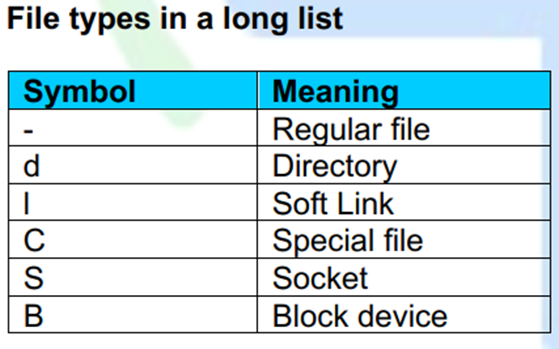

Slide 93
Default colour schemas for files types
Colour | File type
Blue | Directories
White | Text files
Pink | Images
Yellow | Devices
Flashing Red | Broken Links
Red | Compressed archives
Cyan | softlinks
Green | Executables

Slide 94
File Commands
touch filename :used to create a single file
touch f1 f2 f3 :used to create multiple files
touch file{1..5} create 5 files at a time
rm filename :used to remove single file
rm f1 f2 f3 :used to remove multiple files
rm file{1..5} used to remove 5 files
m -f filename used to remove a file without our permission
rm -f * :used to remove all files at a time

Slide 95
Folder or Directory commands
mkdir command
- make directory
- used to create a new folder
- can create multiple folders at a time
- folders with hierarchy
Eg: mkdir folder used to create single folder
mkdir devops
mkdir folder1 folder2 :used to create multiple folders
mkdir folder{1..7} create 7 folders at a time

Slide 96
mkdir with Options
mkdir -p a/b :create folder b inside folder a if a is present otherwise it will first create a then b inside a
rmdir folder :used to remove empty directory
Ex: rmdir devops
rmdir * used to remove all empty directories
rmdir -rf folder/* used to delete all the files inside the folder
rmdir -rf folder/filename used to delete the particular file inside the folder
rmdir -rf folder/filename used to delete the particular file inside the folder
rm -rf * used to remove all files and folders at a time
touch folder/filename used to create a file inside the folder

Slide 97
Changing Directories
cd foldername :used to change the directory
cd .. used to go back to one step back
cd ../../.. used to go back to 3 folders back
cd - used to go back to the previous directory
cd (or) cd ~ used to go back to root directory at a time
cd (or) cd ~ used to go back to root directory at a time
pwd :present working directory. If you want to check the current path use this command

Slide 98
ls command
ls :used to see only file names
ll (or) ls -l used to see all the files along with the data (l - original list)
ls folder1 :used to see the list of files present in folder1
ll -a (or) ls -al :used to see the both hidden and regular files
ll -r (or) ls -r used to see the files in reverse order
ll -r (or) ls -r used to see the files in reverse order
ll -ltr To list the files in long listing format with sort by modification time, newest first and then in reverse order

Slide 99
COPY
cp file1 file2 used to copy the data from source file1 to destination file2
Note: Here, if file2 i.e.., destination file is not created also, it will create automatically
Ex: cp test.sh test1.sh
cp file1 folder1 :used to copy the file to folder
Ex: cp test.sh devops

Slide 100
mv (MOVE) command
mv file1 file2 :used to move/renaming the files i.e.., the data from file1 to file2
Ex mv test1.py test2.py
mv file1 folder1 :used to cut the file and paste in folder
mv test2.py devops
cmp file1 file2 :used to compare the 2 files
diff file1 file2 :used to get the differences of a file b/w 2 files

Slide 101
cat command
cat filename used to read the data into a file
Ex:cat test.sh
cat f1 f2 f3 used to see all the files data at a time
Ex: cat test.sh test.py test.java

Slide 102
tac command
tac filename : reverse the data from top to bottom
Ex: tac test.sh
rev filename :reverse the data from left to right

Slide 103
head command
head filename used to print first 10 lines of a file
Ex: head test.txt
head -n 8 filename prints 8 lines in a file

Slide 104
tail command
tail filename used to print last 10 lines of a file
Ex: tail test.txt
tail -n 4 filename :used to print last 4 lines in a file

Slide 105
wc command
wc filename :used to get the no of lines, words, letters in a file
Ex:
wc -l filename used to get only line numbers of a file
wc -w filename used to get no of words in a file
wc -c filename used to get no of characters in a file

Slide 106
more command
Used to display content of large/very large files, In form of pages
more command loads the entire file at a time into memory
Used to see the multiple files data at a time
Used to see all the files data at a time with % press space enter or traverse
eg: more f1 f2

Slide 107
less command
large/ very large display files in form of pages
It will loads the parts of the data into memory that is displayed
we do have search capability use /word name, After perform less command
eg: less filename
When compare with less/more user prefer less command because we got some free space in memory/ram
our ultimate aim is If ram is free means system is speed

Slide 108
locate
It is light weight command, used to find a file
It searches for given file in backend database which updates once in a day
problem when we search for a newly created file
#sudo updatedb - used to update the database
#locate filename

Slide 109
find command
used to search for a file/folder
Find do not depend on any database if actually searches on file system
Find provides multiple options for searching a file eg: name, size, group, user, date, permissions, etc..,
Note:- Some times you are trying to find some files you got permission denied errors, On that case use sudo before the command
find path(or)pathType -name filename
find / -name file
find / -iname f1
find /home/ec2-user -name file
find / -type d -name fol-name
find / -type f -perm 0644

Slide 110
grep command
Global Regular Expression print
It is used to search for a word inside a file, without going inside a file
grep "searchwordname" filename
grep -n "wordname" aws
grep -i "wordname" aws
grep "wordname" aws -c (wordcount)
Search multiple words inside a file
grep -e "1stword" -e "2ndword" filename
grep -e "1stword" -e "2ndword" filename
grep -e "wordname" file1 file2
search multiple words and multiple files
grep -e "word" -e "word" file1 file2

Slide 111
File Modifications or Editors
Vim editor: It is used to modify the data in a file.
It has 3 modes
command mode
Insert mode
save & quit mode

Slide 112
vi or vim editor
1. command mode
It is the default mode in vim editor. It is used for operations like copy, delete, paste the lines in a file
keys/commands:
In linux we can't press the keywords directly. you have to do in esc mode
yy : used to copy the entire of the line
3yy: copies 3 lines from our cursor
p : used to print the copied data
4p : it will print 4 times
dd : used to delete the entire line
5dd: used to delete 5 lines
gg : used to go to the 1st line of the file
G : used to go to the last line of the file
5gg: our cursor goes to the 5th line
shift:8 -> our cursor goes to the 8th line
u : used to undo the changes
ctrl+r : used to redo the changes
shift:set number -> used to give the numbers in a file
/word or ?word -> used to search a word
shift:%s/old word/new word/g -> to replace a word (g - global)

Slide 113
2. Insert mode
Used to insert the data in a file
esc: used to go to insert to command mode
i : used to go to command to insert mode
O : used to create a new line (up)
o : used to create a new line (down)
A : used to go to the end of the line
I : used to go to the starting of the line

Slide 114
3. save & quit mode
It is used to save the modified data in a file
And quit from the VI editor to root user
:w - used to save the data in a file
:q - used to quit from the vim editor
:wq - used to save & quit from the vim editor
:w! - forcefully save the data in a file
:q! - forcefully quit from the vim editor
:wq! - forcefully save & quit from the vim editor
Note: All these vim keys will work on command mode
4. visual, reverse, record modes - we don't use here

Slide 115
Nano editor
Its another editor in linux
Ex: nano text.sh
You can directly add or modify or delete the data in a file
For saving the file: ctrl+o hit enter
For exit: ctrl+x quit the file

Slide 116
User Management
Adding user
using adduser/useradd command
used to add a new user into linux os
Eg: adduser username
adduser -u 8765 pop
adduser -u 6578 -gid 8765 bob
note: whenever we create user, one group also will gets created with the same
whenever we create user, Inside /home automatically folder will gets created with same name

Slide 117
Backend process
controller will edit the following files
/etc/passwd - contains info about users in linux OS. we can see the users in our servers. First, last are the actual users. In
b/w there are system user accounts we called as daemons.
/etc/shadow - users password info present
/etc/group - contains info about groups in linux OS
/etc/gshadow - groups password info present

Slide 118
Removing user
using userdel command:
user delete
used to remove a user from linux os
Eg: userdel dhoni
userdel -r virat - delete user in both server & home directory
userdel -r -f rohit
delete user in both server & home directory and also deleted user related files
note: - whenever we delete the user, only user is deleted not the folder
At a time, we can delete single user only

Slide 119
File Permissions
- If you want to give all permissions to the file
- very important
- directly impact on security of os
using chmod command
change mode
used to change permissions for a file

Slide 120
Permissions in OS
read(r) : we can access data inside file/folder = 4
write(w) : we can change /alter data in file/folder = 2
execute(x): we can execute/ run file = 1
- : type of a file = 0
permissions are given to three set of people
owner(u): who actually creates the file/folder
group(g): every user is associated with a group
others(o): everyone other than group and owner comes under others
ls -l
drwxrwxrwx d : file / folder rwx : permissions of owner rwx : group permissions rwx : other permissions

Slide 121
we can change permissions of a file/ folder using 2 ways
1. using operators
+ : add a permission
- : removes a permission
= : replicates permission
Eg: chmod u+x file
chmod u-x,g+w,o+r abc
chmod u=rwx abc
chmod a+x abc

Slide 122
2. using numeric codes
rwx
000 - 0 - no permissions
001 - 1 - execute
010 - 2 – write
011 - 3 - write and execute
100 - 4 - read
101 - 5 - read and execute
110 - 6 - read and write
111 - 7 - all permission
Eg: chmod 123 abc
chmod 456 abc - for file
chmod 777 abc
chmod -R 777 folder1 - changing permissions in files inside the folder also
note: file name will change when we give/change the execute permissions

Slide 123
SSH
- It is a protocol, nothing but secure shell
- used to remotely connect and control a system - both systems should be in the same network
- Through ssh we can login into remote server to our computer
note: If both servers are using same n/w SSH will be possible otherwise don't
Eg: service ssh status
service ssh start
service ssh stop
service ssh restart
ssh username@serverpublicIP
Login through cmd from remote server

Slide 124
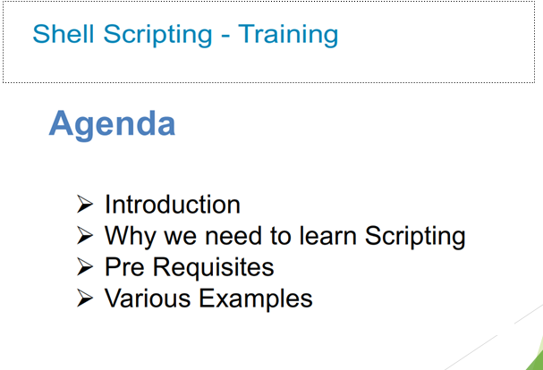

Slide 125
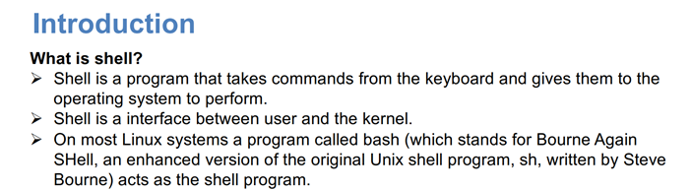

Slide 126
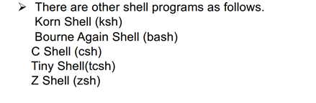
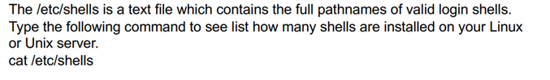
Shell types

Slide 127
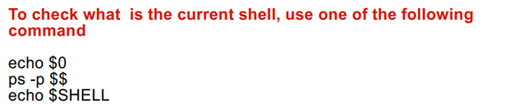
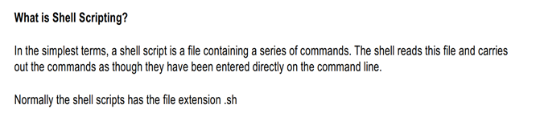

Slide 128
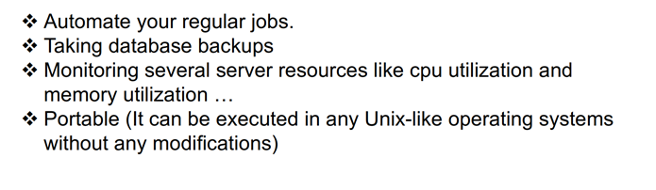
Why we need to Learn ShellScripting

Slide 129
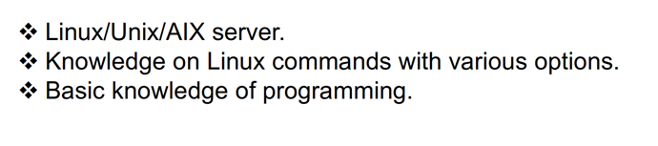
Pre-Requisites

Slide 130
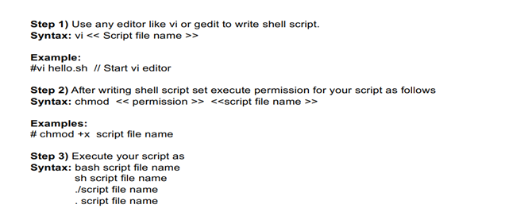
Steps to Write Shell Script

Slide 131
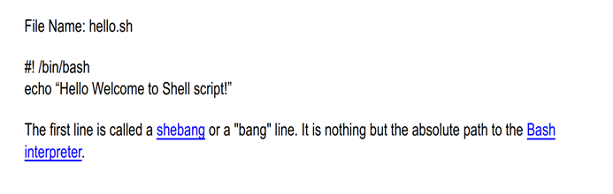
First shell script example

Slide 132
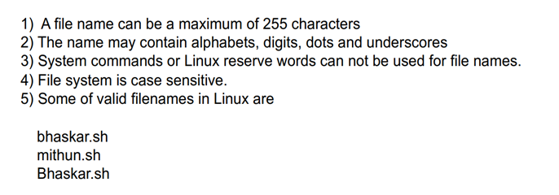
File Naming Conventions

Slide 133
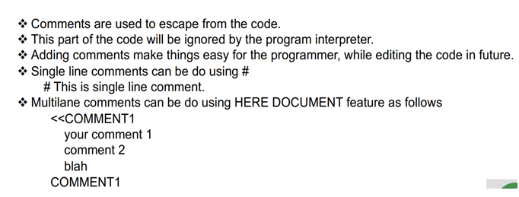
Comments in Shell script

Slide 134
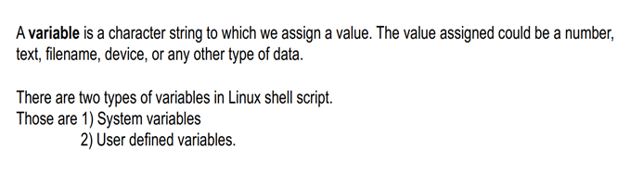
Variables in Shell Script

Slide 135
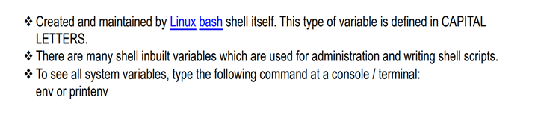
1.System Variables

Slide 136
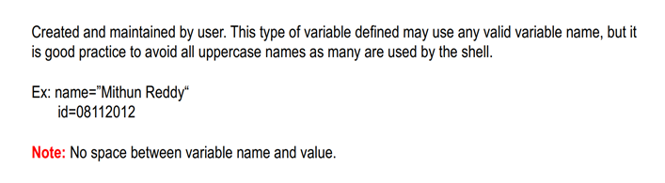
2.User Defined Variables

Slide 137
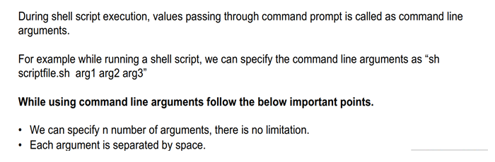
Command Line Arguments in Shell Script

Slide 138
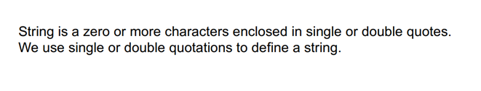
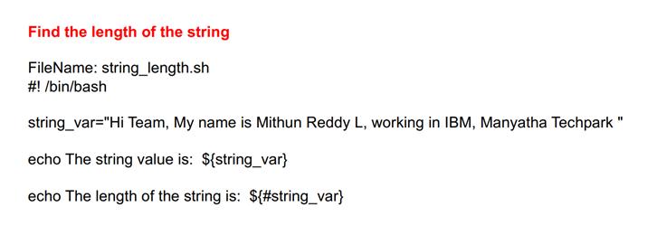
String In Shell Script

Slide 139

Arthimetic Operations In Shell Script

Slide 140


Read command in Shell Script

Slide 141



Slide 142

Input and Output Redirection

Slide 143


Slide 144

Control Commands in Shell Script

Slide 145


Slide 146


Slide 147


Slide 148


Slide 149


Slide 150


Slide 151


Slide 152

Functions in Shell Script

Slide 153


Slide 154


Slide 155

Pipes In Shell Script

